Slide 1

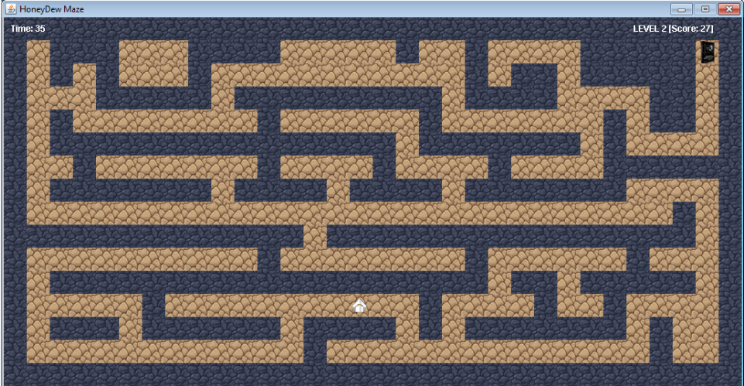
The HoneyDew Maze
Team Honeydew Presents
We’ve created a simple Maze game (Labyrinth) with simple design.
This is a new adventure and challenge for SoftUni students.
You can read the code and update your levels in it.
The demo game has 3 levels for beginners.
https://github.com/Harizanov/Honeydew

Slide 2

How did we work as a team
We communicated via Skype – conference call, group chats
On survey basis we decided the type of game we will work on
We discussed the project structure and assigned tasks
We helped each other to write the code with daily group chats
Altogether we went through the code and discussed it thoroughly
Finally we’ve had the result “HoneyDew Maze” game!

Slide 3

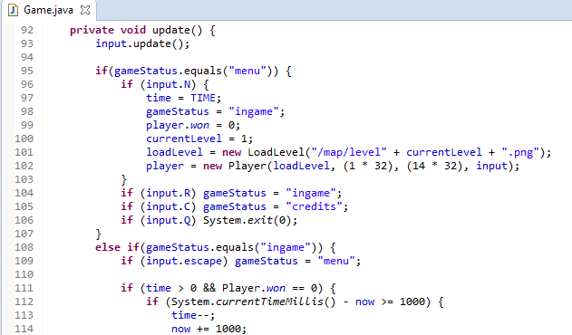
Main Features
Control menu
Different map routes
3 levels with different difficulty
Score estimated on time rest
Different speed levels

Slide 4
Who did what
Ivan Zahariev | Team leader – Class Game && Menu & more
Neli Iordanowa | Class LoadLevel
Petar Harizanov | Class Player && maps design
Ana Kaneva | Class Render
Georgi Dimitrov
Biliana Atanasova | Class Input
Elena Rangelova | Package level.tiles; Class Sprite
https://github.com/Harizanov/Honeydew

